Slide 1
SOEN 6841: Software Project Management
Yang Zhou, Jinsong Liu, Kaichen Zhang
Zhu Liu, Yu Luo, Ruijia Yang
Kundi Yao, Mo Chen

Slide 2
Business problem
Key improvements have not been delivered as promised
Delivery estimation is also unknown
Buffered lots of backlogs of deferred enhancement
Disagree with the number of staff assigned to the project

Slide 3
Business Goal
Key improvements have not been delivered as promised
Delivery estimation is also unknown
Buffered lots of backlogs of deferred enhancement
Disagree with the number of staff assigned to the project
Improve the quality of the software

Slide 4
Solution
Key improvements have not been delivered as promised
Improve quality of the source code
Improve the reliability of the software release
Delivery estimation is also unknown
Improve communication with the customer
Buffered lots of backlogs of deferred enhancement
Manage the priority of solving backlog
Improve the quality of design and development documentation
Disagree with the number of staff assigned to the project
Improve the performance of organization

Slide 5
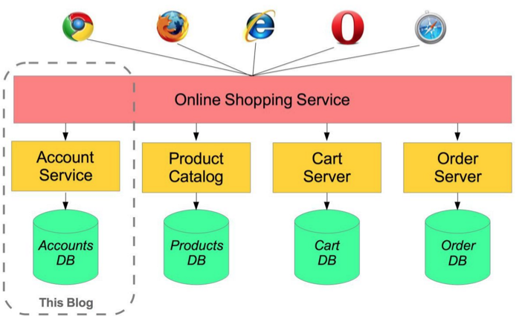
Architecture Overview

Slide 6
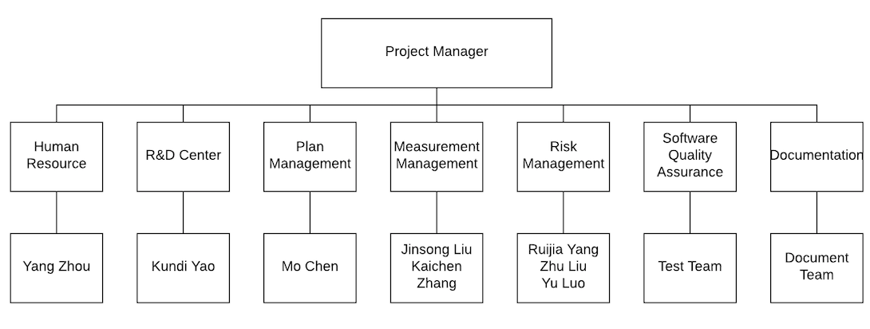
Organization

Slide 7
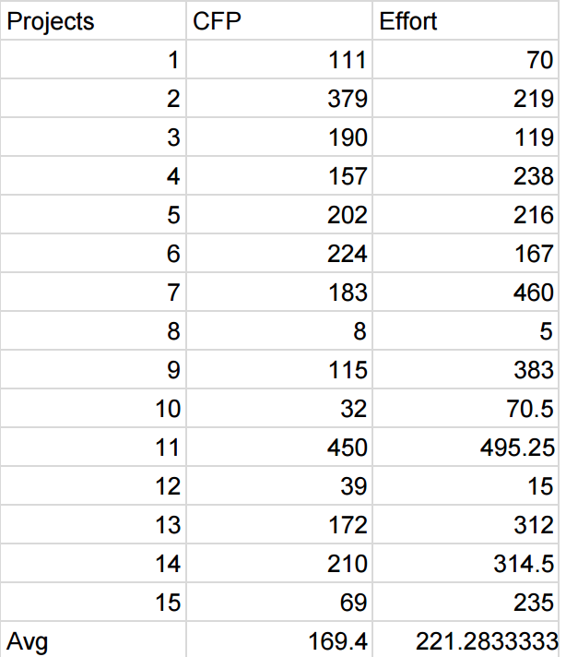
Feasibility
Functional size (function point-based) method to estimate the overall workload.
Based on history data, we build our estimation model to predict actual effort.

Slide 8

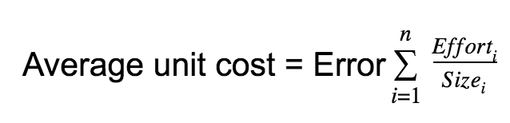
Feasibility
In our model:
Average unit cost: 0.94
Mean Magnitude Relative Error(MRE): 24.8%(recommended is +-25%)
Effort= 0.94*CFP

Slide 9
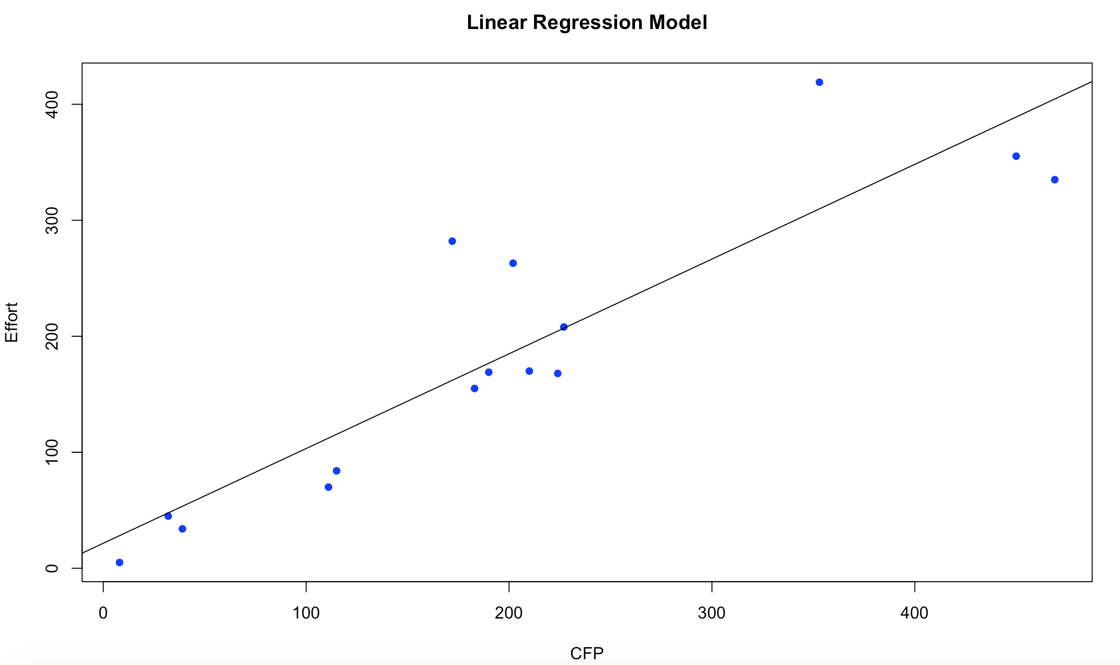
Feasibility
If R² is | The relationship is
0.9R² | Predictive; use it with high confidence
0.7≤R²<0.9 | Strong and can be used for planning
0.5≤R²<0.7 | Adequate for planning but use with caution
R²<0.5 | Not reliable for planning purposes
Effort=21.60+0.82*CFP
Coefficient of regression(R²): 0.819

Slide 10
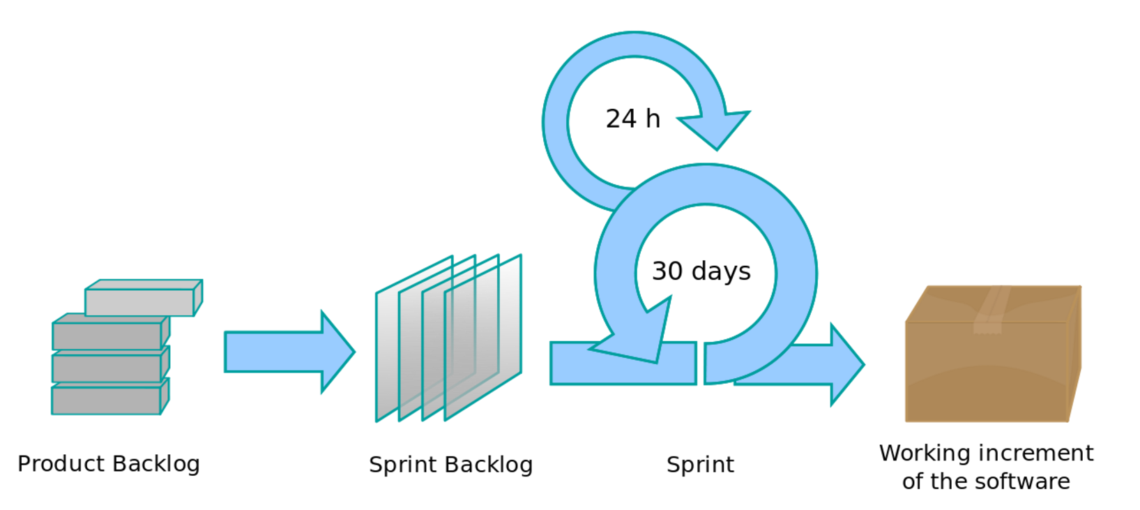
Agile

Slide 11
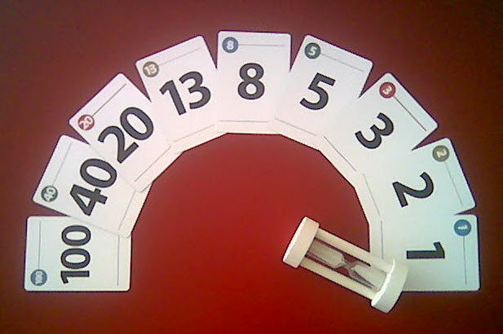
Agile
Planning Poker technique to
estimate story points
Function Process | User Story | Story Points
FP1. Select Product Group | User Story 1. As a user, I can select product group. | 2
FP 2. Search product | User Story 2. As a user, I want to be able to Search product | 3
FP 3. Display product | User Story 3. As a user, I want to be able to Display product | 3
FP 4. View size chart | User Story 4. As a user, I want I can View size chart | 2
... | ... | ...

Slide 12

Agile
T-shirt sizing to prioritize user stories
( Priority:
1 = advanced-upper 2 = advanced-lower
3 = intermediate-upper
4 = intermediate-lower 5 = low )
User Story | Development cost | Business value | Priority
User Story 1 | medium | medium | 4
User Story 2 | low | high | 2
User Story 3 | medium | medium | 3
User Story 4 | high | medium | 3
User Story 5 | Low | high | 1
... | ... | ... | ...

Slide 13
Agile
iteration | User Story | Story Points
1 | User Story 5 User Story 6 | 10
2 | User Story 8 User Story 10 | 10
3 | User Story 2 User Story 3 User Story 4 | 8
4 | User Story 1 User Story 11 | 10
5 | User Story 7 User Story 9 | 8
Iteration Partition
Velocity = 10
Iteration=
Estimate Size/ Velocity

Slide 14
Budget—Delphi Method
No. | Task Name | Duration (days) | Start | Finish | Predecessor | Effort | Resource names
.. | ... | .. | ... | ... | ... | ... | ...
20 | Iteration 5 | 25 | 01/16/17 | 02/10/17 | 19 | 150 | Develop Team
21 | User Story 7 | 15 | 01/16/17 | 01/31/17 | 20 | 90 | Develop Team
22 | User Story 9 | 10 | 01/31/17 | 02/10/17 | 21 | 60 | Develop Team
23 | Plan Measurement | 10 | 09/24/16 | 10/04/16 | 6 | 88 | Measurement Manager
24 | Perform Measurement | 145 | 10/24/16 | 02/15/17 | 6 | 534 | Measurement Manager
25 | Analysis Measurement | 145 | 10/24/16 | 02/15/17 | 6 | 215 | Measurement Manager
26 | Hold weekly meetings with stakeholders | 140 | 09/24/16 | 02/13/17 | 5 | 560 | Risk Manager
... | ... | ... | ... | ... | ... | ... | ...

Slide 15
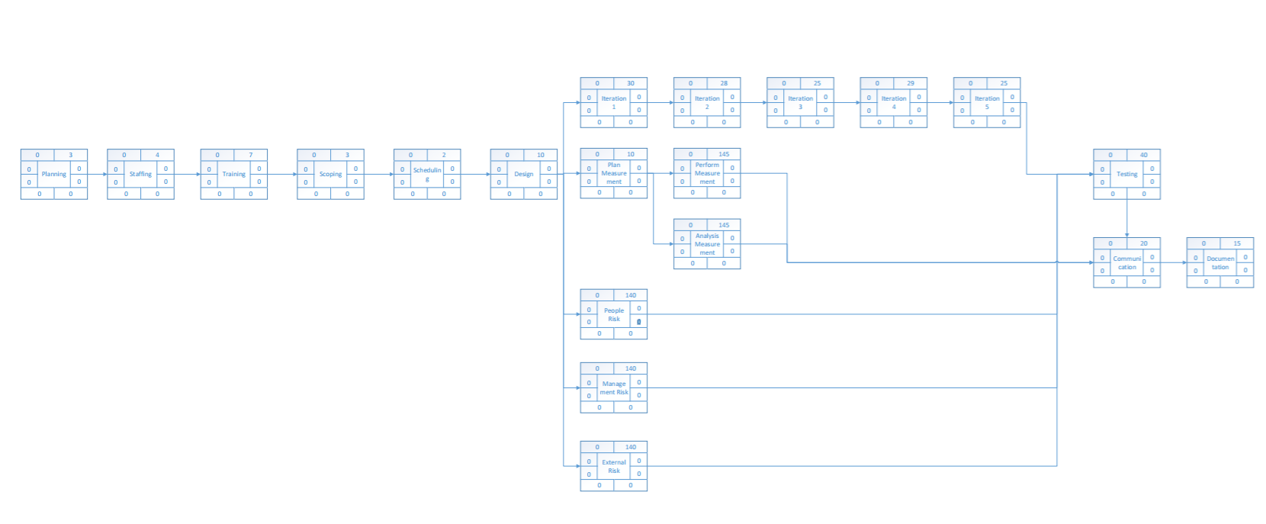
Critical Path Method(CPM)

Slide 16
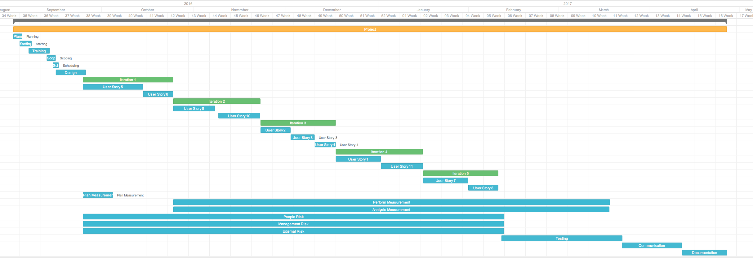
Scheduling
Duration
Predecessors
Resources names
Start and finish dates of the terminal elements
Summary elements of a project
Dependency relationships between activities.
Organize the work schedule and develop work line for the whole project

Slide 17
Measurement
Indicator & Success criteria
Indicator | Evaluation | Success criteria
DKLOC | defects/KLOC | ≤ 0.92‰
ratio of CCMin | CCMin/CCSum | ≥ 80%
Code Readability | The Number of GOOD | The Number of GOOD ≥ 2

Slide 18
Measurement
DKLOC Indicator
Review Phase | DKLOC
source code | 50‰
code compile | 25‰
self-inspection | 5‰
code review | 2‰
unit testing | ≤ 0.92‰

Slide 19
Measurement
Cyclomatic Complexity Indicator
Cyclomatic Complexity | Risk Evaluation
1-10 | a simple program, without much risk
11-20 | more complex, moderate risk
21-50 | complex, high risk program
greater than 50 | untestable program(very high risk)

Slide 20
Measurement
Cyclomatic Complexity Indicator
Language | CCMin(1-10) | CCMid(11-20) | CCMax(21-50)
Java | 80% | 15% | 5%
Python | 85% | 10% | 5%
C | 70% | 20% | 10%
C++ | 79% | 12% | 9%

Slide 21
Measurement
Code readability Indicator
Factor | Good | Medium | Bad
Comments ratio | 35%-50% | 20%-35% | < 20%
Proper indent styles | 90%-100% | 80%-90% | < 80%
Qualified naming conventions | 95%-100% | 90%-95% | < 90%

Slide 22
Data Elements Required | Indicator
 | DKLOC Indicator | Cyclomatic Complexity(CC) Indicator | Code Readability Indicator
Defects_minor | ×
Defects_medium | ×
Defects_significant | ×
Defects_critical | ×
Defects_catastrophic | ×
SLOC | × |  | ×
Statements |  | × | ×
Lines of codes with comments |  |  | ×
Lines with proper Indent styles |  |  | ×
Lines need Indent styles |  |  | ×
Numbers of entities with qualified naming conventions |  |  | ×
Numbers of entities that need qualified naming conventions |  |  | ×
Nodes(control flow) |  | ×
Edges(control flow) |  | ×
The number of the set of the graph(control flow) |  | ×
CCMin |  | ×
CCMid |  | ×
CCMax |  | ×

Slide 23
Measurement
Success criteria
Indicator | Evaluation | Success criteria
DKLOC | defects/KLOC | ≤ 0.92‰
ratio of CCMin | CCMin/CCSum | ≥ 80%
Code Readability | The Number of GOOD | The Number of GOOD ≥ 2

Slide 24
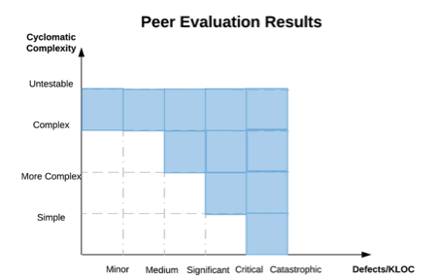
Measurement
Peer review

Slide 25
Planning task
No. | Planning Tasks | Effort (Hours) | Start time | End time | Predecessor | Budget (1k Dollars)
0 | Process planning: identify the needs of measurements | 16 | 09/24/16 | 09/25/16 |  | 0.5
1 | Identify the objectives of the organization. | 24 | 09/26/16 | 09/28/16 | 0 | 0.8
2 | Identify the methods that will be used to achieve the objectives. | 16 | 09/29/16 | 09/30/16 | 1 | 0.4
3 | Identify the issues that need to be managed, controlled or observed. | 16 | 10/01/16 | 10/02/16 | 0 | 0.4
4 | Translate each measurement issues into precise, quantify and unambiguous measure goals.. | 16 | 10/03/16 | 10/04/16 | 0 | 0.5
5 | Data elements defined | 65 | 10/24/16 | 11/03/16 | 0 | 1.5
6 | Data collection frequency and points in the software process defined | 64 | 11/04/16 | 11/13/16 | 5 | 1.5
7 | Timelines defined for measurement result to data bases and users | 67 | 11/14/16 | 11/23/16 | 6 | 2.0
8 | Data collection forms defined | 64 | 11/24/16 | 12/03/16 | 7 | 1.5
9 | Data collection procedure defined | 65 | 12/04/16 | 12/13/16 | 8 | 1.5

Slide 26


Slide 27

Preparations
Purpose, project sponsor, objectives, resources, scope.
Project team responsibilities.
Meeting guidelines

Slide 28
Risk identification
R1: Lack of stakeholder’s involvement
R2: Integrating with third party systems
R3: Huge change request late in the project
R4: Problems caused by new technologies
R5: Unexpected software abnormalities (“bugs”)
R6: Key project team member sick/urgent leave/quits
R7: Over-emphasis on low priority details.

Slide 29
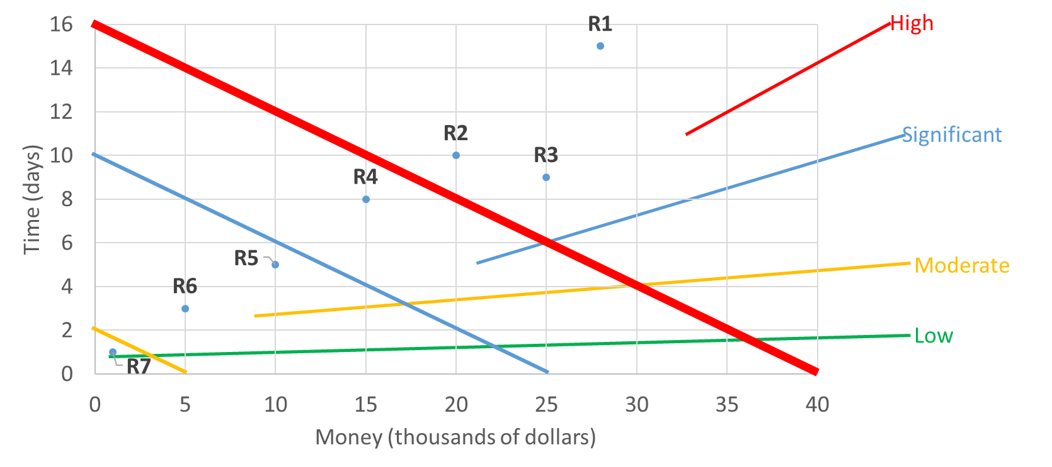
Risk Qualification and Prioritization
We use brain storming and Delphi method to estimate impact of each risk and put them into Risk Profile Chart to determine the severity.

Slide 30
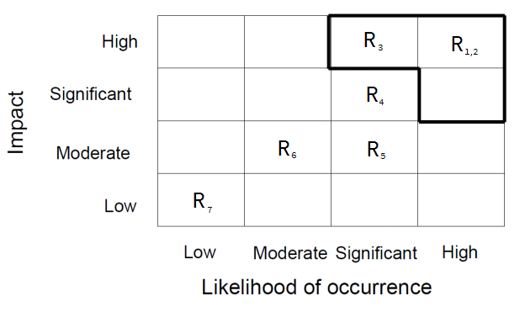
Risk Qualification and Prioritization
We use likelihood-impact chart to identify the top priority risks.

Slide 31
Risk Monitoring
Track high concerned risks in the current iteration
Decide the countermeasure plan when the risk is triggered
Close the outdated risks
Identify the new risks and update

Slide 32
Risk Mitigation and Avoidance
Risk | Risk strategy | Considerations
R1: Lack of stakeholder’s involvement | RiskMitigation | 1. Set up a communication plan...... 2. Hold weekly meetings with stakeholders to get their feedbacks.
R2: Integrating with third party system | RiskMitigation | An experienced staff to assist the integration, which can lower down the probability of the risk.
R3: Huge change request late in the project | RiskMitigation | 1. Proper requirements analysis is to be done beforehand and scope statements must be signed and accepted by stakeholders and project sponsor. 2. Hold weekly meetings with stakeholders. 3. Set up prior mutual agreement with stakeholders.

Slide 33
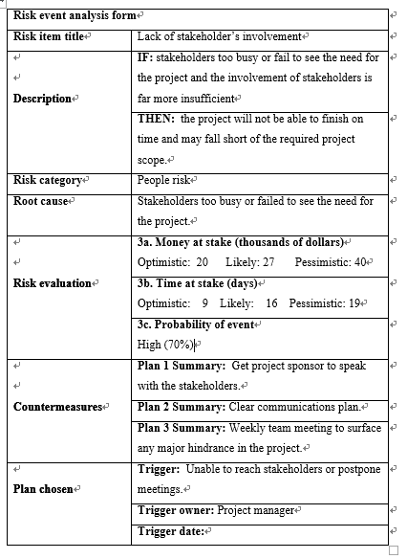
Risk register

Slide 34
Budget & Schedule
The total budget:
Software R&D Cost = 254,474 Dollars
Measurement Cost = 17,700 Dollars
Risk = 73,000 Dollars
The total project cost is 345,174 Dollars
This project is highly recommended

Slide 35
Contribution
Team member | Project Plan | Measurement Plan | Risk Management Plan
Yang Zhou | R | R | S
Jinsong Liu | S | R
Kaichen Zhang |  | R
Ruijia Yang | S | S | R
Zhu Liu |  |  | R
Yu Luo |  |  | R
Kundi Yao | R | S
Mo Chen | R | S

Slide 36
Thanks!

